Slide 1
Welcome to
King’s College
Financial Aid Night
Janua

Slide 2

Financial Aid
Financial Aid is assistance to help students fund their education. It can take the form of:
    Scholarships
    Grants
    Loans
    Employment

Slide 3
Gift Aid vs. Self-Help Aid
GIFT AID
Grant/Scholarship = Aid awarded that does not have to be repaid.
SELF-HELP AID
Loans = Borrowed money that has to be repaid over a period of time, often after the student completes their degree. Available to students and parents
Work-study = Money students earn by working on campus.

Slide 4
Merit versus Need-Based
Merit-Based Aid (Need blind)
  Academic record
  Skills or talents
  Involvement - community service; extracurricular activities
Need-Based Aid = awarded on the basis of financial need. Re-evaluated each year as financial situations may change.
Notes:
Merit Based Aid = need blind awarded upon admission to students strictly on the basis of merit. Does not have to be repaid. Renewable each year contingent upon maintaining academic criteria and satisfactory progress towards degree.

Slide 5
File the FAFSA
  One primary application for all types of
  need based financial aid and federal loan programs available from :
  Federal Student Aid
  State governments
  King’s College

Slide 6


Slide 7
Getting Ready
Before starting the FAFSA, gather:
  (student and parent)
    Social Security cards or Permanent resident cards
    2013 federal income tax form (even if not completed) and W2 forms
    Records of untaxed income
    Current bank statements (as of filing date)
    Business, farm and other real estate records
    Records of stocks, bonds and other investments
    (including 529 accounts)
      Asset information may not be required
Notes:
Recap: Here is a list of records you should have available in order to complete the FAFSA. Completing the FAFSA will be easier and less time consuming if you gather these records before going on-line.
You will need :
-Your driver’s license (optional), and
-Your Alien Registration Card (if you are not a U.S. citizen)
You and your parents may need:
- Social Security cards
- W-2 forms and other records of any money earned in 2012
-2012 federal income tax return data (if completed). Remember, federal tax returns do not need to be completed to apply for student financial aid.
- Records of untaxed income (includes VA non educational benefits, child support paid/received, workers compensation)
- Current bank statements (as of filing date)
- Business/farm and other real estate records
- Records of any stocks, bonds and other investments (asset information may not be required).
Keep in mind that not all families will have all of these records. For future reference, be sure to keep copies of all financial aid documents used to complete the FAFSA, and a copy of the completed FAFSA . You and your family must reapply each year for financial aid.

Slide 8
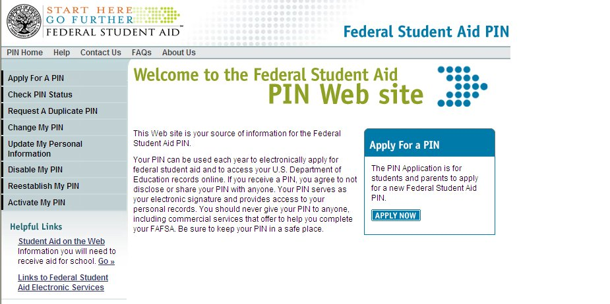
Student Financial Aid (SFA) PIN
Web site: www.pin.ed.gov
Pin # used to sign FAFSA electronically
May be used by students and parents throughout aid process, including subsequent school years
Link to Pin website is also on FAFSA website
Notes:
PIN is assigned to the Individual once. Don’t need to reapply. Parent will need pin to sign FAFSA and Promissory notes for PARENT PLUS loan.
If more that one in college, parent may use same pin number but each child will need their own.

Slide 9
PIN Usage
If filing FAFSA online,
  Parent & student sign electronically. Must first apply for PIN at http://www.fafsa.gov
    PIN can be created or will be emailed to student for immediate use.
    PIN serves as e-signature
Additional PIN uses:
submit info and make corrections online.
sign Promissory Notes for Direct Loans.
Access Financial Aid history on NLSDS

Slide 10
FAFSA-Filing Tips
  Based on prior calendar year tax return
  May use estimated income and taxes
  May submit prior to college acceptance
  PA residents must file by May 1 for state grant consideration; state will follow up with student (via email)

Slide 11
Three Ways to File FAFSA
File FAFSA on the WEB (FOTW) ; www.fafsa.gov
Download electronic FAFSA PDF file, print, complete and mail or complete PDF FAFSA online, print and mail
Request paper FAFSA from Federal Student Aid Information Center (FSAIC) at 1-800-4-FED-AID or 1-800-433-3243
Notes:
Do no file at FAFSA.com. Google will bring that link up first. Free help is available online, through high school guidance office , college financial aid offices, PHEAA and agencies such as Educational Opportunity Center.
The PDF FAFSA is available for you to print and fill out manually or is screen-fillable. Screen-fillable means you can enter your data on the screen before printing. If you choose this option you will not be able to save your data to your PC.

Slide 12
FAFSA on the Web
Good reasons to file electronically:
Can complete in stages and save and submit when complete
Incomplete applications saved and not submitted will be sent emails after 7 days and again in 14 days if still not submitted
Emails sent to student and parent when both provide email addresses
Notes:
Voice over _ skip logic and built in edits….

Slide 13
FAFSA on the Web
The IRS Data Retrieval continues in 2014-2015 beginning February 2, 2014.
Also available in Corrections
Electronically filed tax return information will be available from the IRS in 2-3 weeks, data from paper tax returns will be available in 6-8 weeks.
Notes:
Not all applicants will be able to use this tool. As series of filtering questions are used to determine eligibility. For example,
Married filing single, head of household. Filers not eligible to use this tool, will need to manually enter income data.

Slide 14
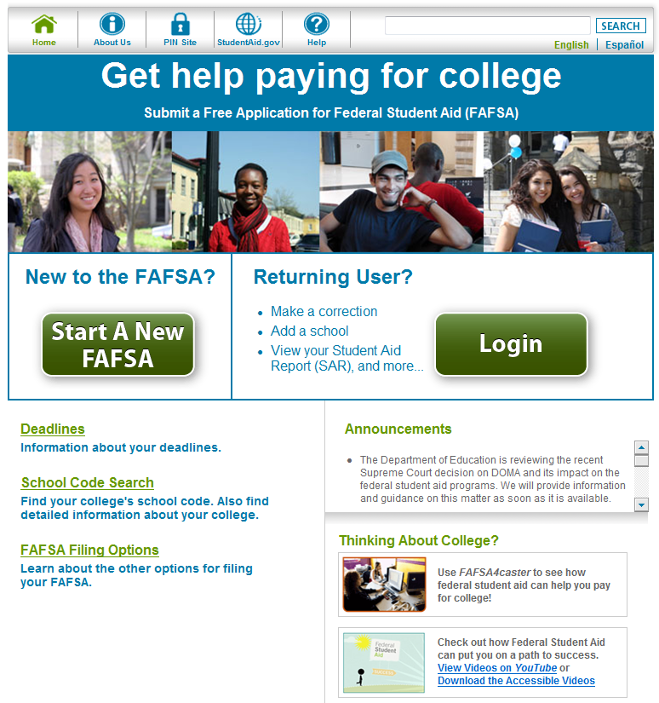
Notes:
The red arrows on this page show the helpful resources on the FAFSA on the Web home page. These include:
Link to the StudentAid.gov web site
Link to the Help Page (shown on the next slide)
Link to the State and Federal Deadlines
Link to the Federal School Code search (helps students find their school codes)
Link to the FAFSA Filing Options.
The PDF FAFSAs for 2014-15 and 2013-14 are available on this page.
Link to FAFSA4caster
Announcements

Slide 15
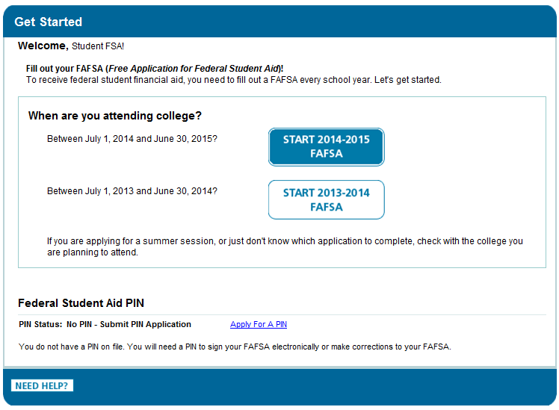

Slide 16
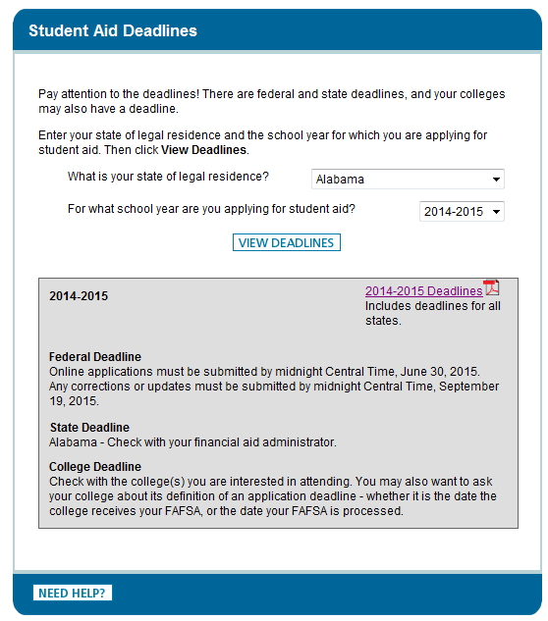
Notes:
The Deadlines functionality on FAFSA on the Web dynamically displays the federal, state and college deadlines for each state. In addition, a full listing of the state deadlines is available in PDF format. Preferred filing deadline of March 1

Slide 17
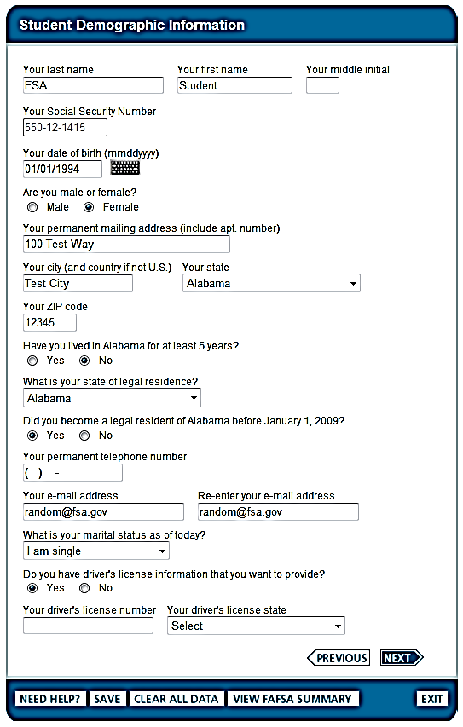
Notes:
Student Demographic Information:
Name, state of legal residence, SSN, student’s email address, Student’s Marital status and Drivers license number
Use full name, no nicknames, abbreviations or initials.
Use correct student’s SSN (check card to assure name and SSN match FAFSA entry)

Slide 18
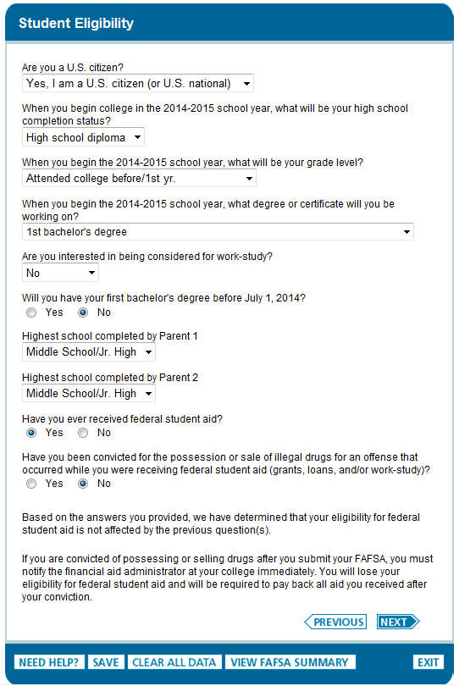
Notes:
Student Eligibility
In order to receive federal student aid, student must be a US citizen or eligible non citizen. Generally , eligible noncitizen’s are:
Permanent U.S. resident with a Permanent Resident card (I-551).
Conditional Permanent Resident wit a Conditional Green Card (I551C)
Holder of an Arrival-Departure Record (I-94) from the Department of Homeland Security showing designations as ”Refugee”, “AsylumGranted”, “Parolee”
T-Visa holder or Cuban-Haitian Entrant
Valid certification from Department of Health and Human Services showing designation of Victim of human trafficking
Parents educational background. This question is used for state scholarship purposes only and does not affect your eligibility for federal student aid. For this question, parent means your birth or adoptive parent. Do not answer this question about a stepfather, legal guardian, or foster parent.
Do not skip Drug sale conviction question. Offense must have occurred while student was receiving federal student aid…therefore does not apply to first time students. Make a reference to Worksheet for “Yes”. FAO would review documentation to determine future eligibility status.

Slide 19
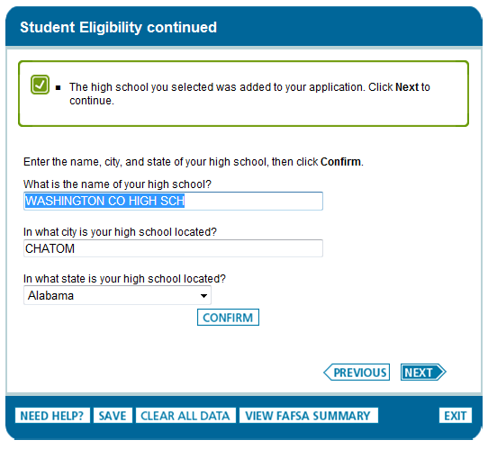
Notes:
If student did not attend high school (home school, GED, etc) …..Check regs on ability to benefit

Slide 20
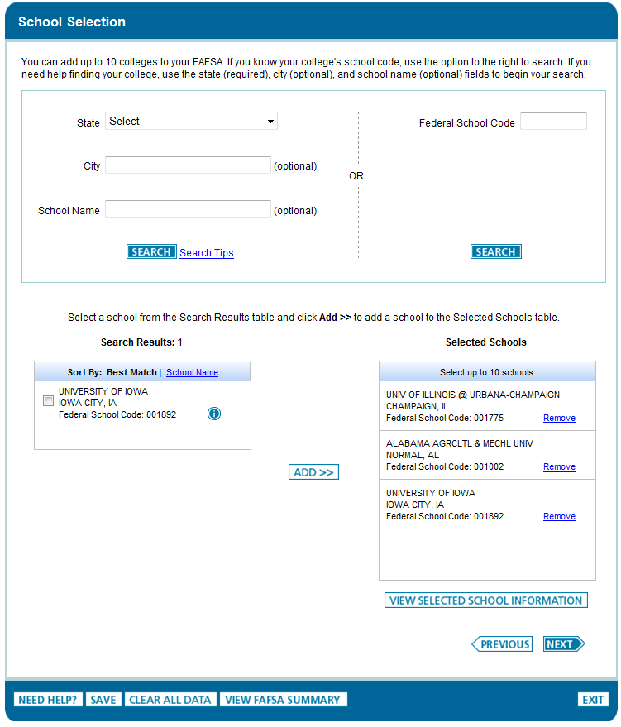
Notes:
You can add up to 10 colleges on your FAFSA.

Slide 21
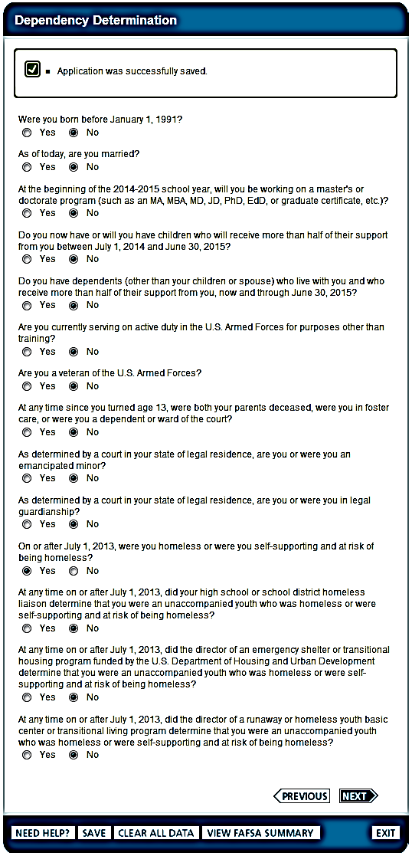
Notes:
The student is asked a series of 13 questions to determine if parental data is required. ( refer to paper FAFSA pg 2). Definition of Legal guardianship does not include your parents, even if they were appointed by a court to be your guardians.

Slide 22
FOTW
Student’s dependency status:
If all “No” responses, student is dependent
If “Yes” to any question, student is independent
Under limited special circumstances, student may submit electronic FAFSA without parental data. If there is a special circumstance, student will be instructed during online application process on how to proceed; documentation will be needed by Financial Aid
Examples of special circumstances: parents incarcerated, left home due to abusive environment, unable to locate and contact parents

Slide 23
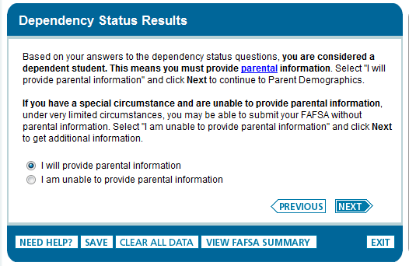

Slide 24
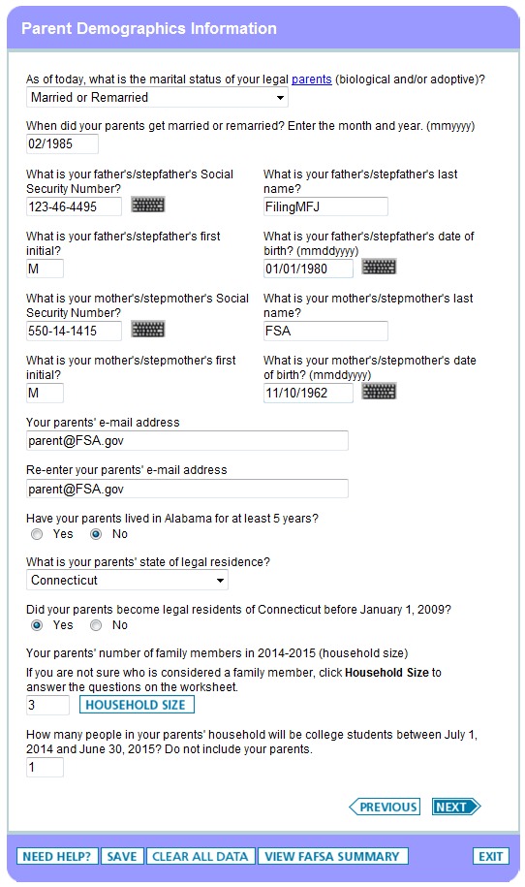
Notes:
Dependent Students must provide Parent Demographic Information =
Data for parents of dependent students Changed mother and father to parent 1 and parent 2
Definition of parent…….
Parents’ name, social security number, date of birth

Slide 25
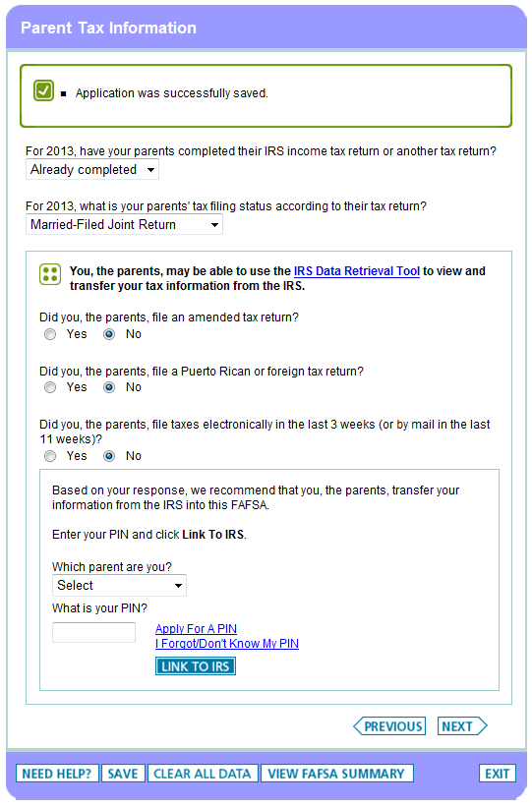

Slide 26
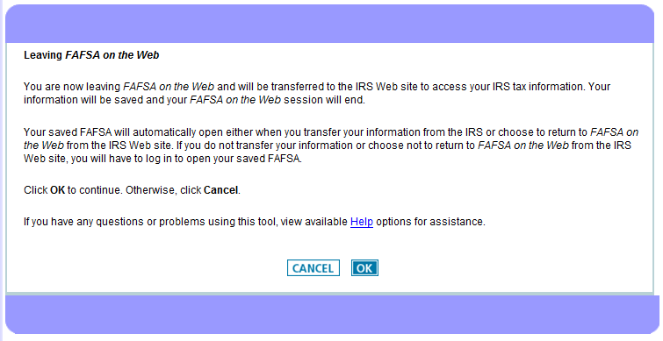

Slide 27
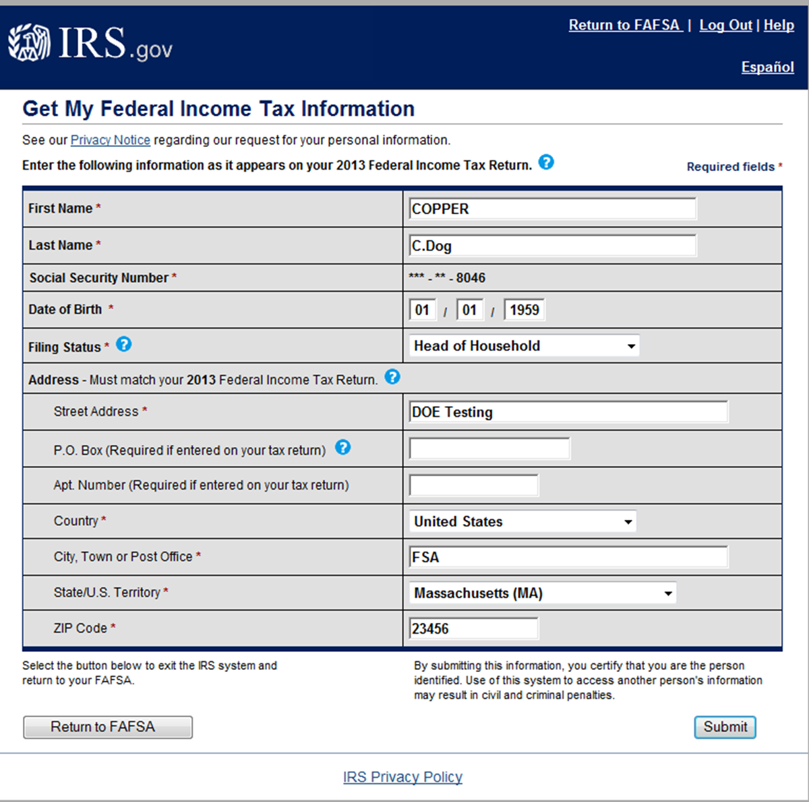

Slide 28
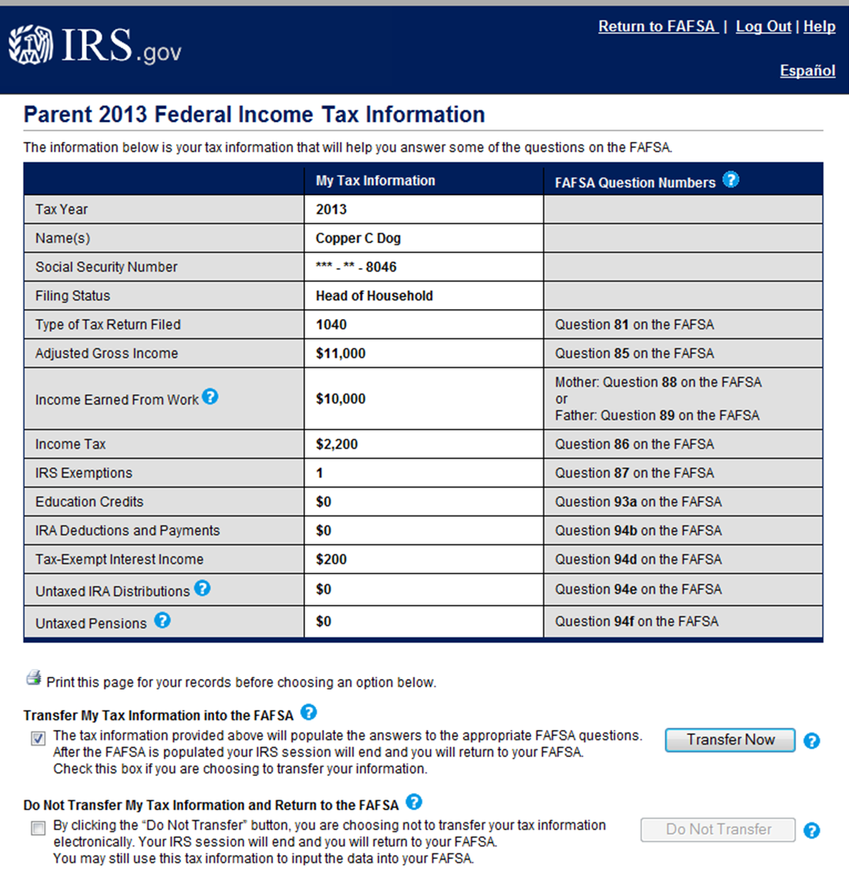

Slide 29
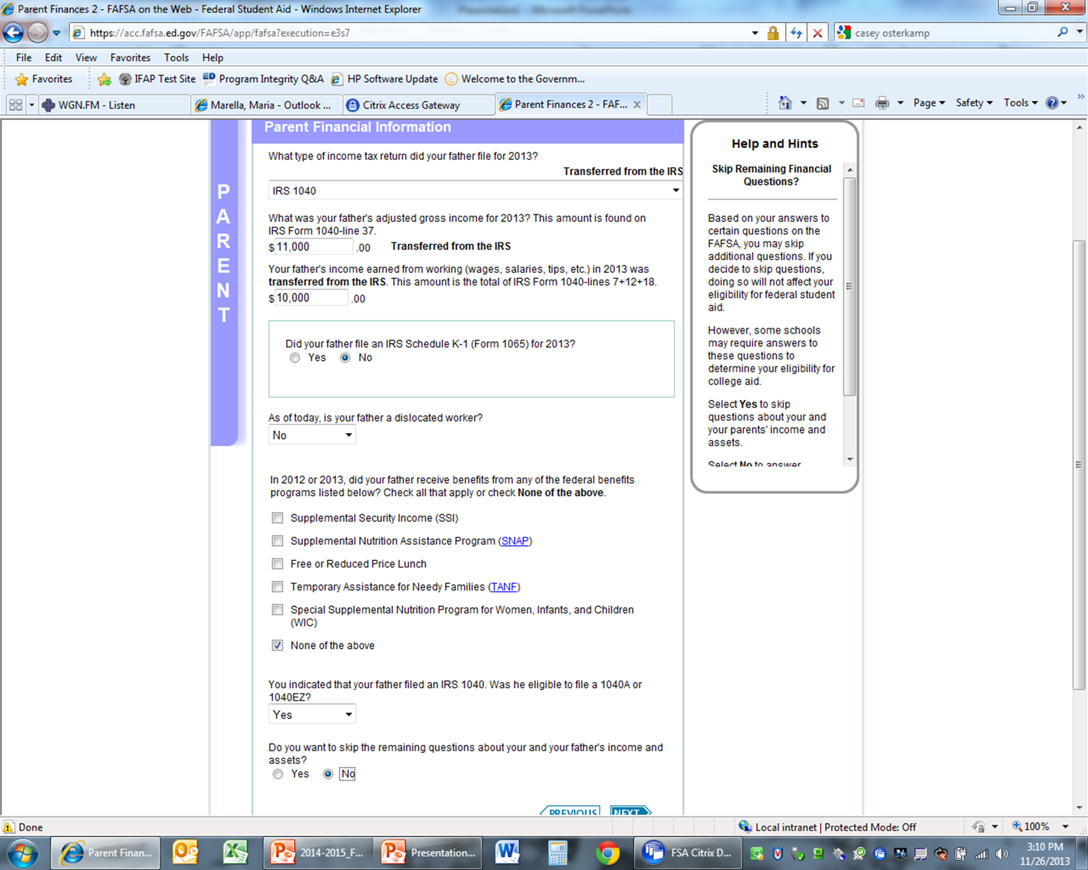

Slide 30
FOTW
Financial data for parents of dependent students:
Tax filing status and return type
already completed, will file, will not file
1040, 1040A/EZ, foreign tax return
wages, adjusted gross income, federal tax paid
Notes:
Tax filing status is important for a number of reasons. It is One of the IRS Data Retrieval tools filtering questions.
Must answer . Tells the Dept of Education if figures are estimated or actual. Return type is important because it will be used as a filter to determine whether or not the student qualifies for special processing formulas. Simplified formula applies to parents with an AGI of less than 50,000 and the Automatic Zero EFC formula applies when the annual income is 24,000 or less. In these cases, no student or parental asset information is required and therefor not a factor in the EFC calculation.
1040A or EZ if income is under 100,000 and don’t itemize deductions , don’t own business, no alimony

Slide 31
FOTW
Data for parents of dependent students:
Are either parents a dislocated worker?
  Job loss, laid off, receiving unemployment, unlikely to return to previous occupation or
  Displaced homemaker – person who previously provided unpaid services to family & is no longer supported by spouse, is unemployed & is having trouble finding or upgrading employment.
  Documentation will be needed by Financial Aid Office

Slide 32
FOTW
Financial data for parents of dependent students:
Adjusted Gross Income (AGI) for 2013
Income earned from work
Notes:
AGI includes interest income, income earned from working, dividends, taxable refunds, alimony, capital gains and losses, rental income, taxable social security and pension distributions. Line ? on 2013 tax return.
Income earned from work is Line 7 and Business income Line 12. Is found on W2 form and schedule C of federal tax return.
This is important on the

Slide 33
FOTW
Financial data for parents of dependent students:
2013 Additional Financial Information
  Education credits on tax return,
  child support paid/received
  payment to tax deferred pension,
  IRA deductions
Notes:
If not listed on tax returns,
Most of the items W2 box 12 a-d and sometimes box 14

Slide 34
FOTW
Cash, savings, and checking
Net worth of investments:
  Net worth equals current value minus debt
  Don’t include primary home, life insurance, retirement plans
  Do include real estate, money market, mutual funds, CD’s, stocks, education savings plans (even if owned by student, parent reports in parent section)
  Review instructions for all items to be reported

Slide 35
FOTW
Asset data for parents of dependent students:
Net worth of business and investment farms:
  Net worth equals current value minus debt
  Don’t include farm if you live on & operate
  Don’t include value of small business if parent owns & controls & has 100 or fewer full-time or full-time equivalent employees
Notes:
Asset data may not be required if criteria for special processing formulas (as previously mentioned) have been met and in this case, you will be prompted to skip the asset questions.
However, the college will reserve the right to request asset information, so you may review and record asset information on the date you filed FAFSA.

Slide 36
FOTW
Student Income and Assets
Adjusted Gross Income/Earned wages
Untaxed Income
Assets
Notes:
For student income there is an income protection allowance of $6,100 for 2014-2015 and the remaining amount is assessed at 50%.
Dependent students must report any assets in their name. They do not receive an Asset Protection allowance. Their reported assets are assessed at 20% .

Slide 37
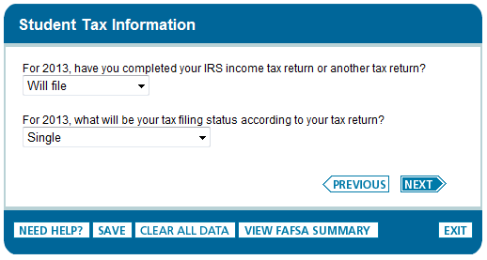

Slide 38
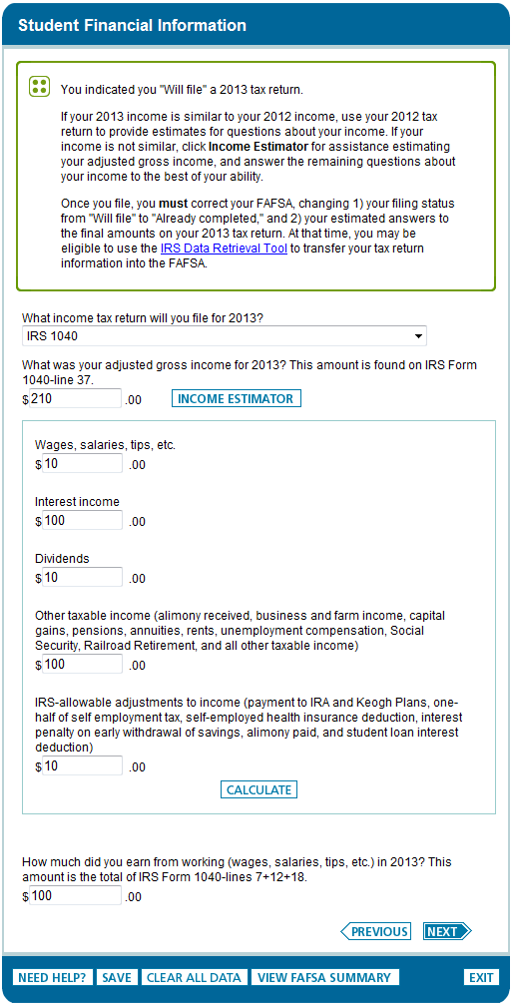

Slide 39
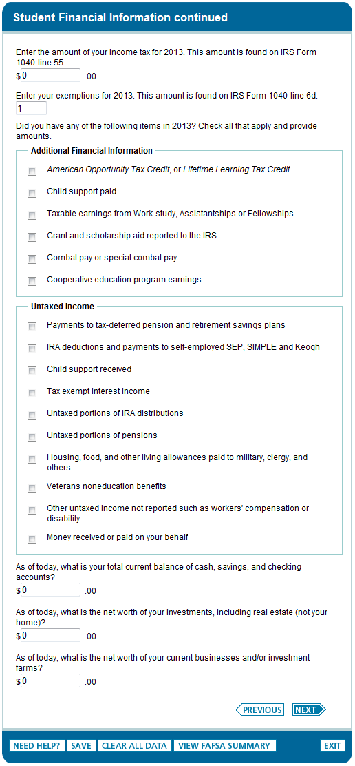

Slide 40
Signatures
Required
  Student
  One parent (dependent students)
Format
  Electronic using PIN
  Signature page
  Paper FAFSA

Slide 41
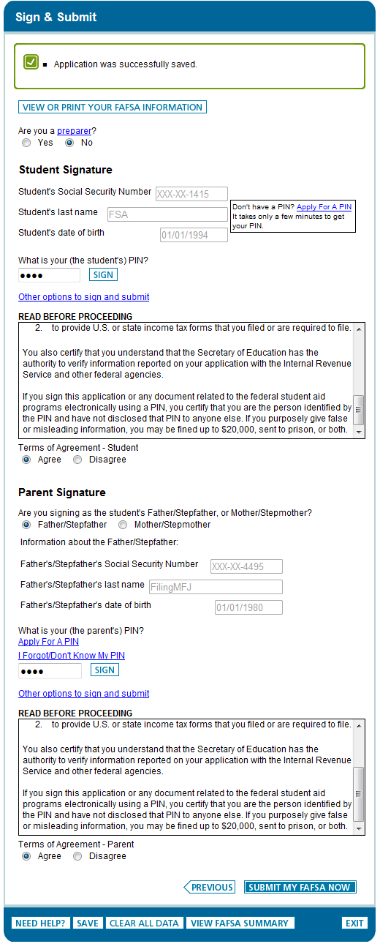

Slide 42
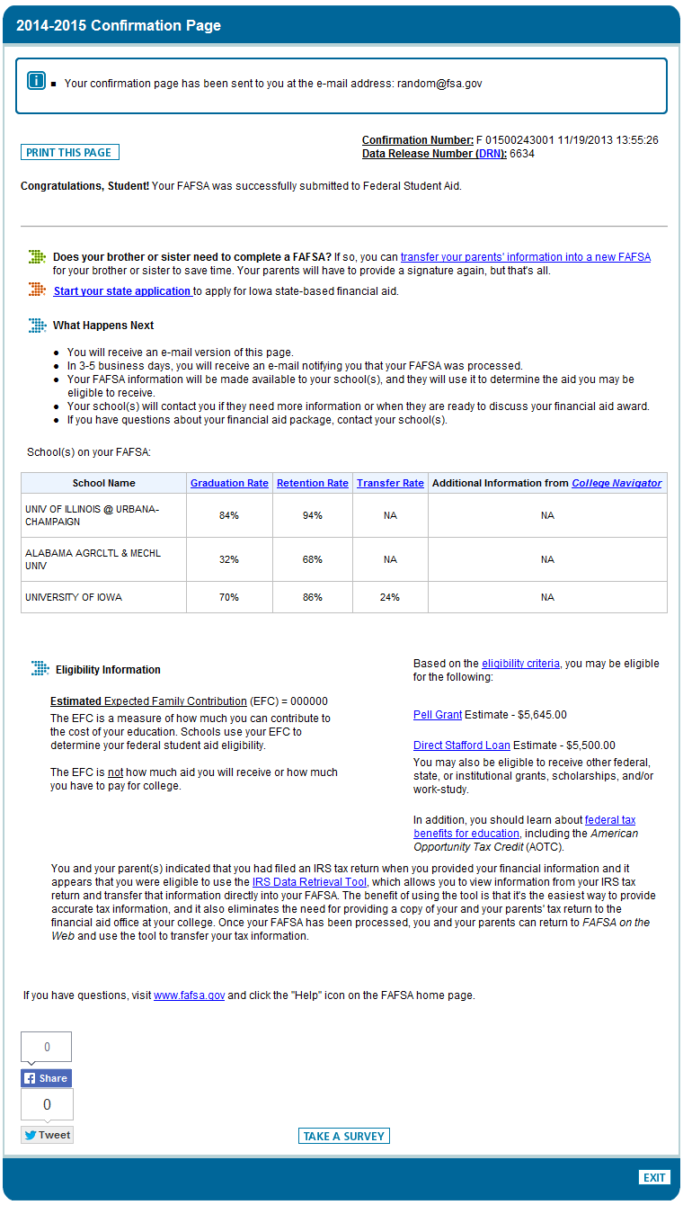

Slide 43
Frequent FAFSA Errors
Social Security Numbers
Divorced/remarried parental information
Income earned by parents/stepparents
Untaxed income
U.S. income taxes paid *
Real estate and investment net worth
Missing signatures
Parent income data in student section
Notes:
*Line 55 1040, line 35 1040A, line10 1040EZ
If you have unusual circumstances that might affect your financial situation complete the FAFSA to the extent you can then submit as instructed and contact FAO

Slide 44
Making Corrections
If necessary, corrections to FAFSA data may be made by:
  Using FAFSA on the Web
  student and parent PIN required
  Updating paper SAR (SAR Information Acknowledgement cannot be used to make corrections); or
Notes:
Go to www.fafsa.gov. Select make corrections. Both student and parent must re-sign the corrected FAFSA.

Slide 45
FAFSA Processing Results
Review data for accuracy
Update estimated income information when actual figures are available using the IRS data retrieval tool.

Slide 46
FAFSA Processing Results
CPS notifies student of FAFSA processing results by:
  E-mail notification containing a direct link to student’s on-line SAR if student’s e-mail was provided on paper or electronic FAFSA
Student with PIN can view SAR on-line at www.fafsa.gov.
Separate electronic record sent to colleges 10 - 14 days after filed; record also sent to state

Slide 47
FAFSA Processing Results
  Paper Student Aid Report (SAR) if paper FAFSA was filed and student’s e-mail address was not provided
  SAR Information Acknowledgement will be mailed if filed electronically via FAFSA on the Web and student’s e-mail address was not provided

Slide 48
EFC-Expected Family Contribution
Once the FAFSA is processed the result is the “Expected Family Contribution” or the EFC.
The EFC is determined by a federal formula and is an index used by the college , federal, and state government to determine need based aid eligibility.
The EFC is not equivalent to out-of-pocket costs.
Notes:
In theory the EFC is the amount the family is able to pay. In reality , and it is rarely the amount a family actually pays.

Slide 49
Cost of Attendance
Includes:
  Tuition
  Fees
  Room and Board
  Books and Supplies
  Personal Expenses
  Transportation
  Loan Fees
Notes:
COA includes both direct and indirect costs.
Example :

Slide 50
Cost of Attendance
  Will vary by college
  Will vary by housing status
  (commuter vs. resident)

Slide 51
Financial Need Varies Based on Cost
Notes:
5

Slide 53
King’s College Timetable
Scholarship notice upon acceptance
Financial Aid Award letters
  First week of March 2014
Admissions Deposit : May 1, 2014

Slide 54
Other Sources of Funds
King’s College Achievement PLUS *
ROTC Scholarships
Office of Vocational Rehabilitation
Private business scholarships (e.g., Wal-Mart, Gates Foundation, etc.)
Civic organizations & churches(e.g., PTA, Elks Club, Rotary, Kiwanis, etc.)
Cp 33 VA benefits – Yellow Ribbon
Notes:
Achievement PLUS is structured program of advisement, counseling, financial assistance and tutoring designed to assist highly motivated students . Eligibility criteria include : first generation (neither parents graduated from college) financial guidelines will be available in February. Interview is required.

Slide 55
Private Scholarship Search
Free Internet scholarship search engines:
College Board: www.collegeboard.com
FastWeb: www.fastweb.com
GoCollege: The Collegiate Websource: www.gocollege.com
Finaid.org: www.finaid.org
Notes:
Also, King’s College maintains private scholarship notices on our web page. www.kings.edu Financial aid

Slide 56
Federal Direct Loans
Student loans available under:
  Federal Direct Stafford Loan Program
School determines loan eligibility and delivers loan proceeds to students
Available to all students, regardless of need
Repayment begins 6 months following graduation, withdrawal or less than half-time enrollment

Slide 57
Federal Direct Stafford Loan
TYPES:
Subsidized
  Based on financial need
  Government pays interest on loan while student is enrolled
  3.86 % interest rate effective 07/01/2013
Unsubsidized
  Non-need-based
  Interest paid either quarterly or capitalized upon repayment
  Fixed interest rate of 3.86%
AMOUNTS: Annual maximums capped by grade level
  $3,500 subsidized/$2,000 unsubsidized - freshmen year
  $4,500 subsidized/$2,000 unsubsidized - sophomore year
  $5,500 subsidized/$2,000 unsubsidized - junior/senior year
  Additional amounts for independent and graduate students
  Loan fees of 1.05 % of approved amount deducted prior to disbursement.
Notes:
_______________________________________________________________________________________________

Slide 58
Federal Direct PLUS Loan
  Credit-based federal loan for:
    Parents of dependent undergraduate students
    Graduate students
    Interest rate 6.41% for 2013-14
    4% origination fee
  Repayment begins 60 days after 2nd disbursement (other repayment options available and forbearance; can defer repayment while student enrolled & can receive 6 month grace period)
  Annual maximum is the “cost of attendance” minus other financial aid student is receiving
  (If a parent is denied due to adverse credit history, a dependent student can access additional Unsubsidized Direct Stafford Loan)

Slide 59
Financing Options
Payment plans – interest free monthly installments
Alternative (non-federal) student loans – credit-worthy co-signer often required; Interest rate variable or fixed

Slide 60
Resources for Students
Institutional Financial Aid Offices
PHEAA: (PA residents
  www.pheaa.org
  1-800-692-7392
U.S. Department of Education:
  www.studentaid.ed.gov
  www.federalstudentaid.ed.gov
  1-800-4FEDAID (1-800-433-3243)

Slide 61
Questions?

